Slide 1
Uncertainty Quantification of Edge Particle Flux of Fusion Plasma in Tokamaks
Bob Junyi Zou Mentor: Prof. Antoine Cerfon, Prof. Benjamin Peherstorfer

Slide 2
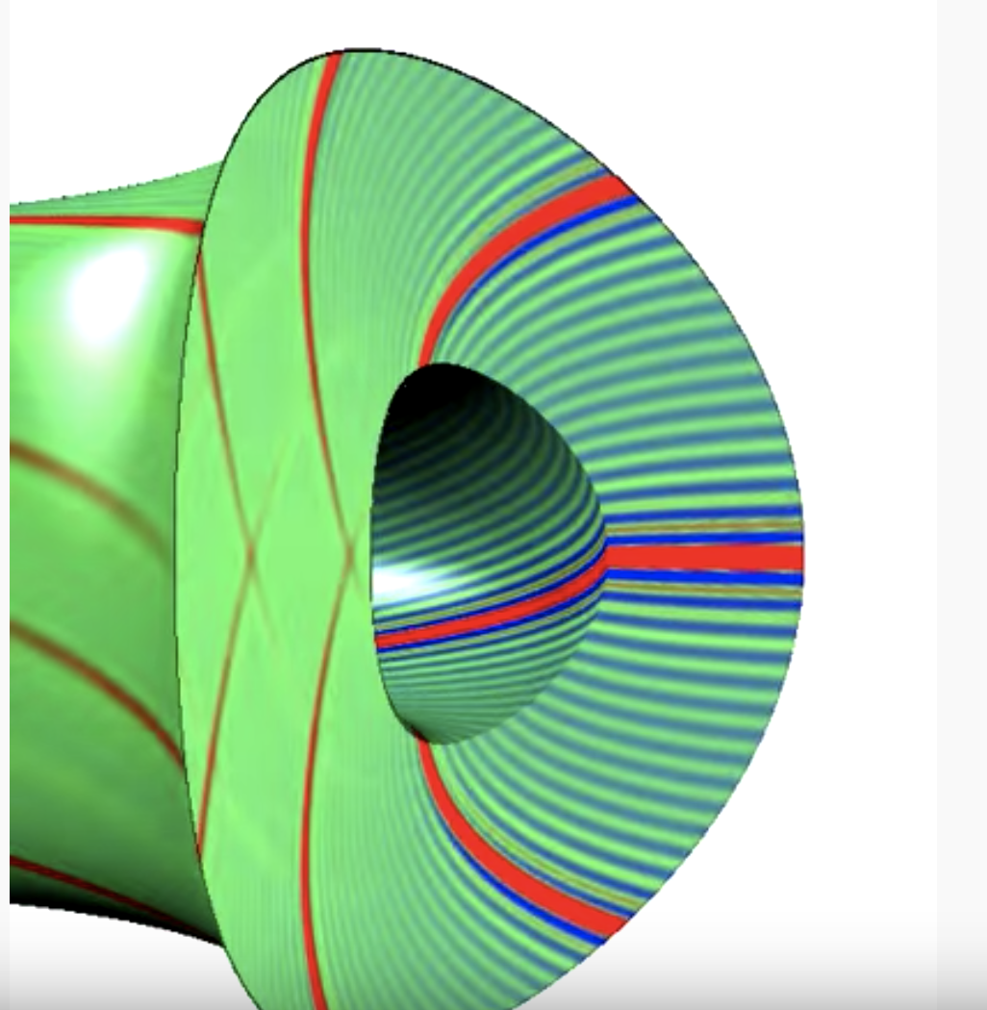
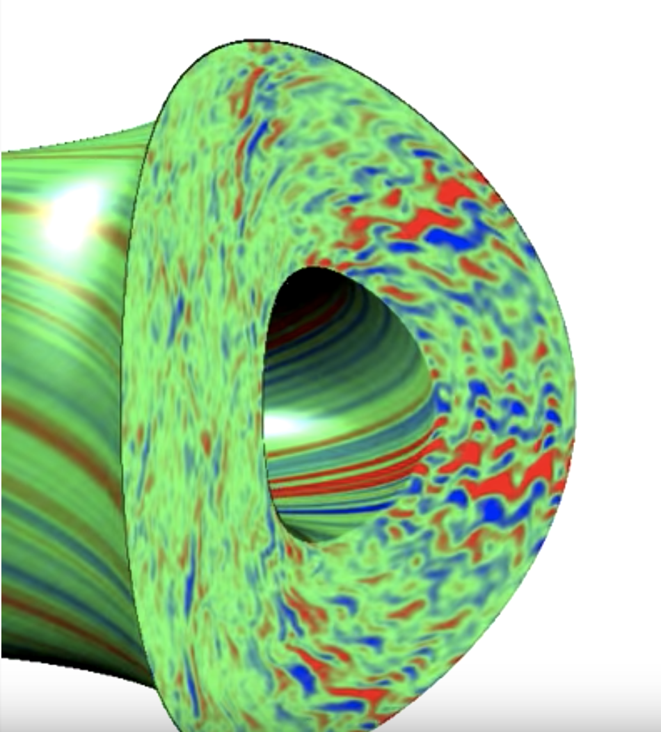
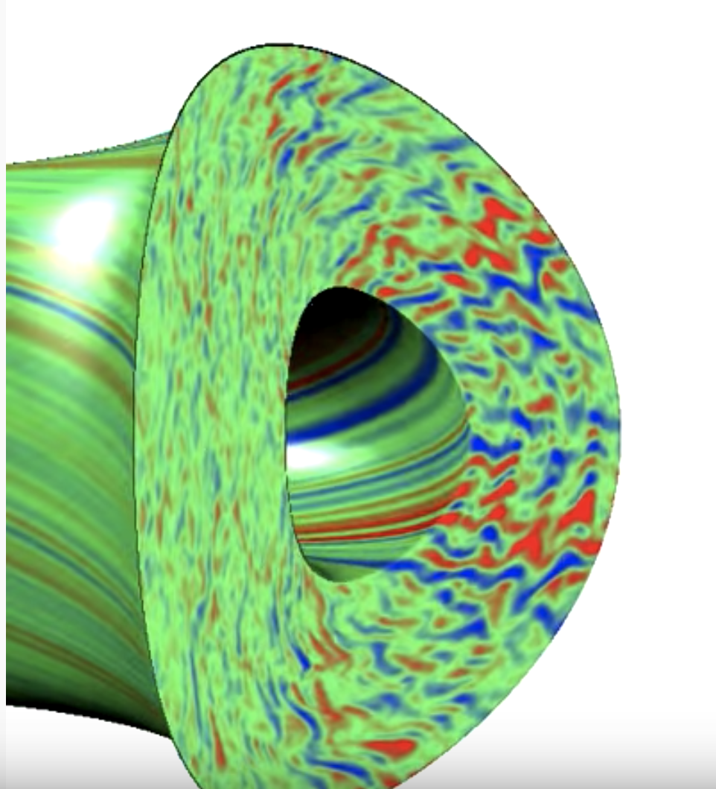
Tokamak Simulation Drift wave instability and zonal flows Reduced particle transport

Slide 3

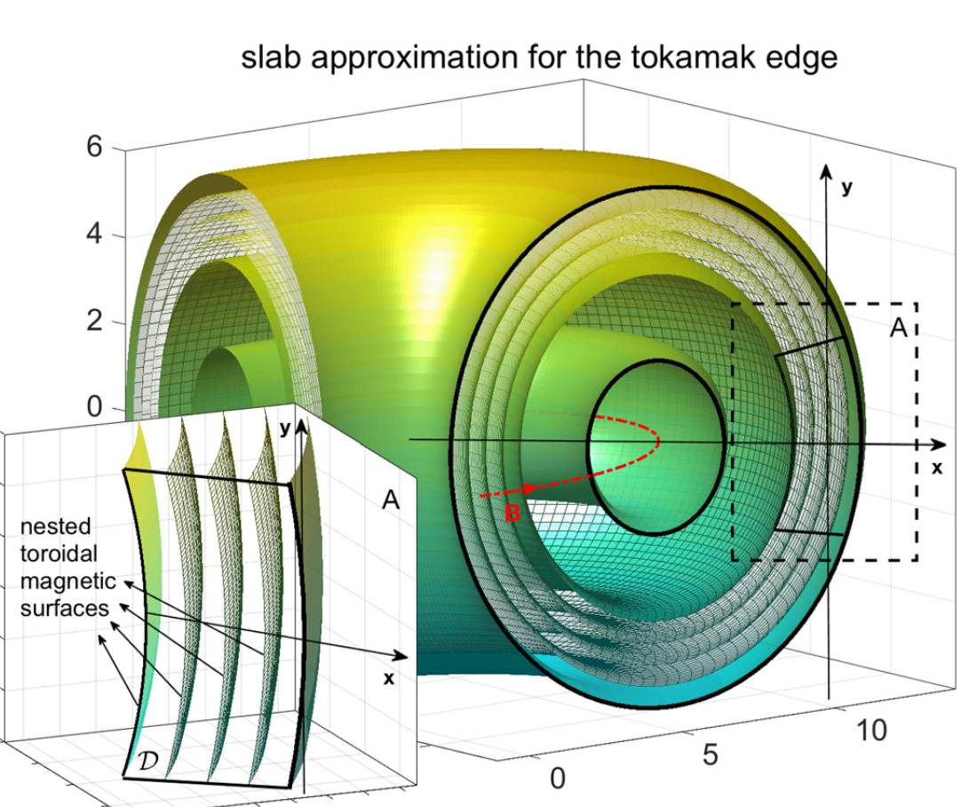
Slab Approximation

Slide 4

Flux-balanced Hasegawa-Wakatani(BHW) model
$\frac{∂q}{∂t}+\vec{v}∙∇q−κ\frac{∂φ}{∂y}=D∆q$
$\frac{∂n}{∂t}+\vec{v}∙∇q+κ\frac{∂φ}{∂y}=α\left(\tilde{φ}−\tilde{n}\right)+D∆n$
potential vorticity
$q=∇×\vec{v}−\tilde{n}=∇^{2}φ−\tilde{n}$
fluctuation about zonal mean
$\tilde{f}=f−\overline{f}=f−\int{f\left(x,y\right) dy}$
by Andrew Majda, Di Qi and Antoine Cerfon

Slide 5

Systematic unstable forced BHM model
$\frac{∂q}{∂t}+\vec{v}∙∇q−κ\frac{∂φ}{∂y}=D∆q+\frac{κ^{2}}{α} \sum{\frac{{ky}^{2}k^{2}}{{(k^{2}+1)}^{3} }{\hat{q}}_{k}e^{\left\{i\vec{k} ⋅\vec{x}\right\}}}$
$q=∇^{2}φ−\tilde{φ}$
$κ=−∇ln⁡(n_{0})$ background density gradient
$α=\frac{1}{η}$ reciprocal of electron resistivity

Slide 6

Numerically Solving the SUF-BHM equation
Spectral Method: Expand quantities in Fourier basis
$φ=\sum{{\hat{φ}}_{\vec{k}}e^{i\vec{k}∙\vec{x}}}$
The Poisson equation governing q and potential becomes trivial
${\hat{q}}_{k}=(−{kx}^{2}−{ky}^{2}−1){\hat{φ}}_{k}$ for non-zonal modes ($ky≠0$)
${\hat{q}}_{k}=(−{kx}^{2}){\hat{φ}}_{k}$ for zonal modes ($ky=0$)

Slide 7

The pseudo-spectral method
After performing the Fourier transform, our PDE becomes a system of “linear” ODEs with one complication:
$$\frac{d{\hat{q}}_{k}}{dt}+{F(−\frac{∂φ}{∂y}\frac{∂q}{∂x}+\frac{∂φ}{∂x}\frac{∂q}{∂y})}_{k}−κiky{\hat{q}}_{k}=−Dk^{2}{\hat{q}}_{k}+\frac{κ^{2}}{α}\frac{{ky}^{2}k^{2}}{{(k^{2}+1)}^{3} }{\hat{q}}_{k}$$
There is a non-linear term, which is a product in physical space but a convolution in Fourier space
The idea: work in Fourier space, but compute the non-linear term in physical space.

Slide 8

Numerical Stability Considerations
De-aliasing: Higher wave-number terms get aliased into lower terms
Solution: Standard 3/2 rule for de-aliasing (zero-padding 3/2 extra modes)
Energy Built-up in small-scale modes as a result of non-linear terms
Solution: Introduce a fictitious hyper-viscosity term $−ν∆^{8}q$
Energy Built-up in large-scale modes in stronger turbulence regime ($κ≈1$)
Solution: Introduce a linear damping term $−dκq$

Slide 9

Choices of Parameters, time-integration scheme and I.C.
$α=5, D=5∙{10}^{−4}, ν=2∙{10}^{−20}, dt=5∙{10}^{−3}, N=256$
Kappa being 0.5 representing weak turbulence regime and 1 for stronger
4th-order Implicit-Explicit Additive Runge-Kutta (ARK4)
Initial condition is generated by N² realizations of $\frac{N\left(0,1\right)}{10}$ with forced periodicity 2pi

Slide 10
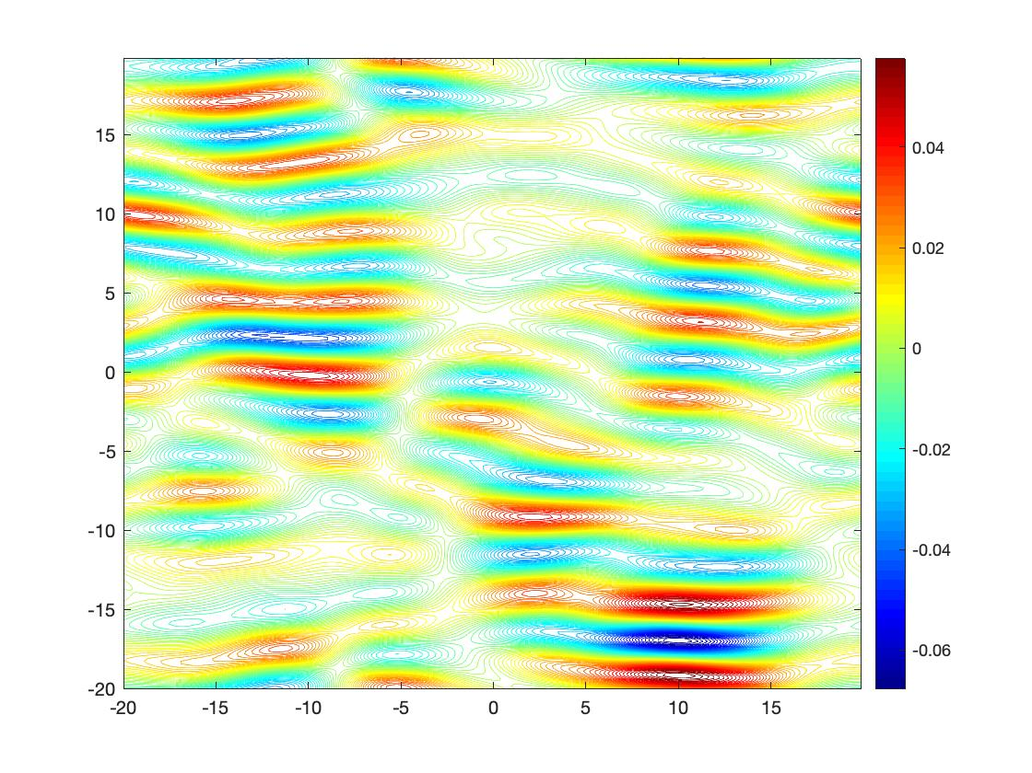
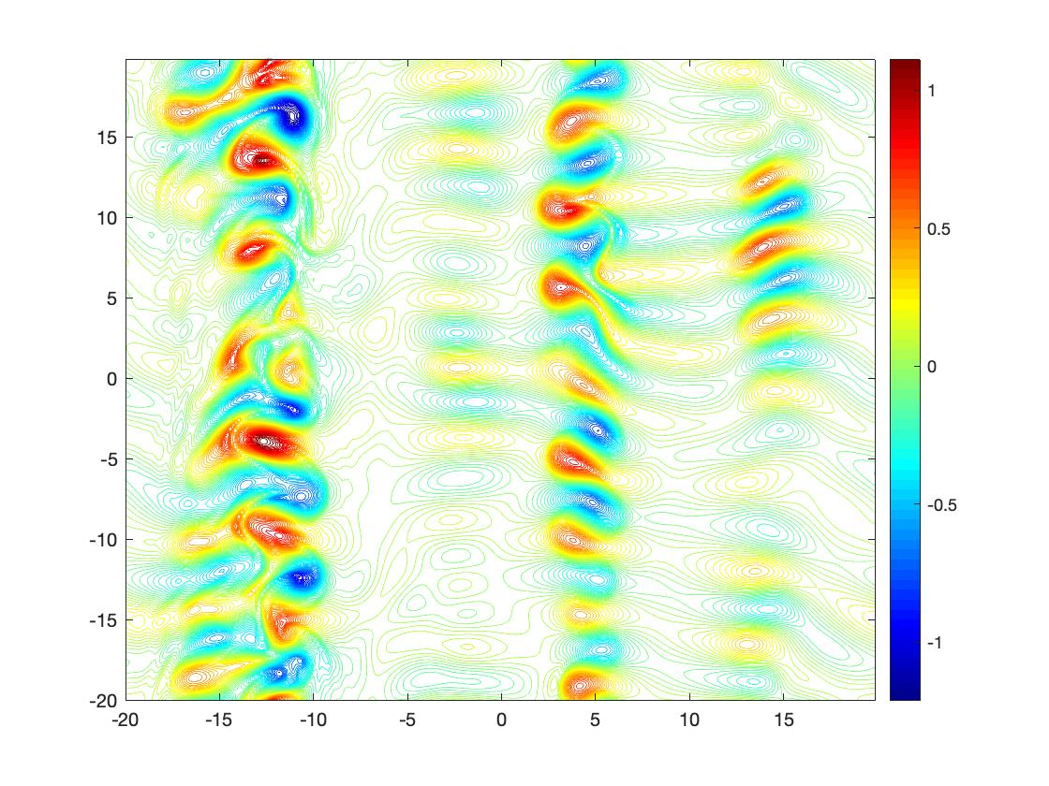
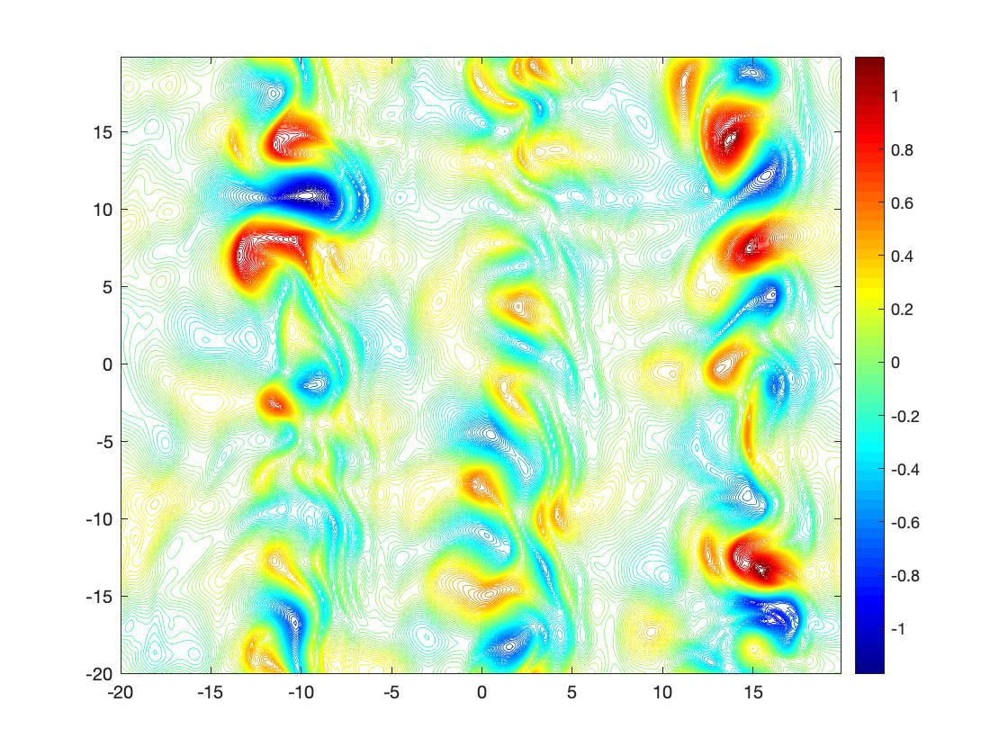

Numerical Results
t=1000
t=1800
t=2500
Contour plots for potential vorticity $q$
$κ=0.5$ weak turbulence regime

Slide 11
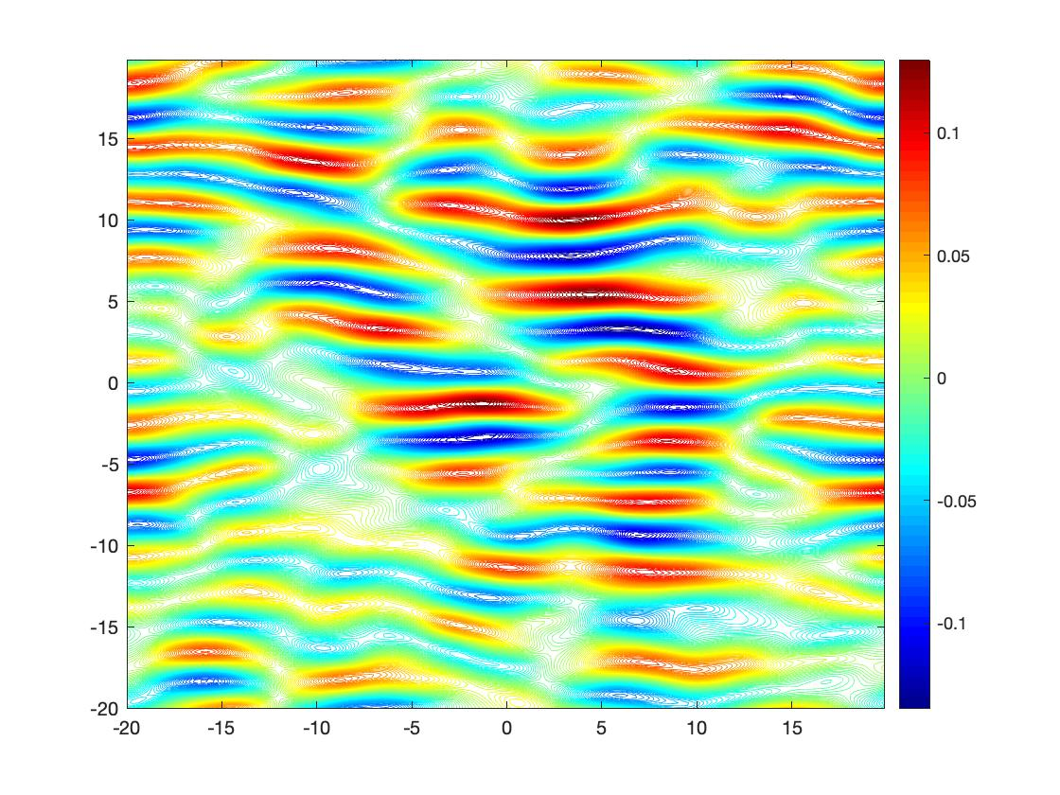
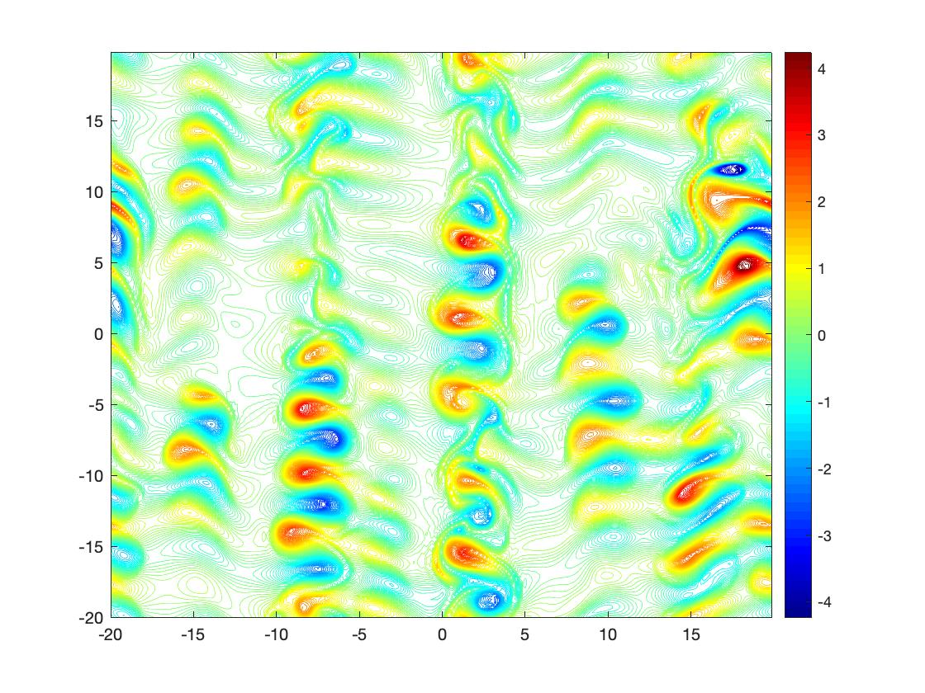
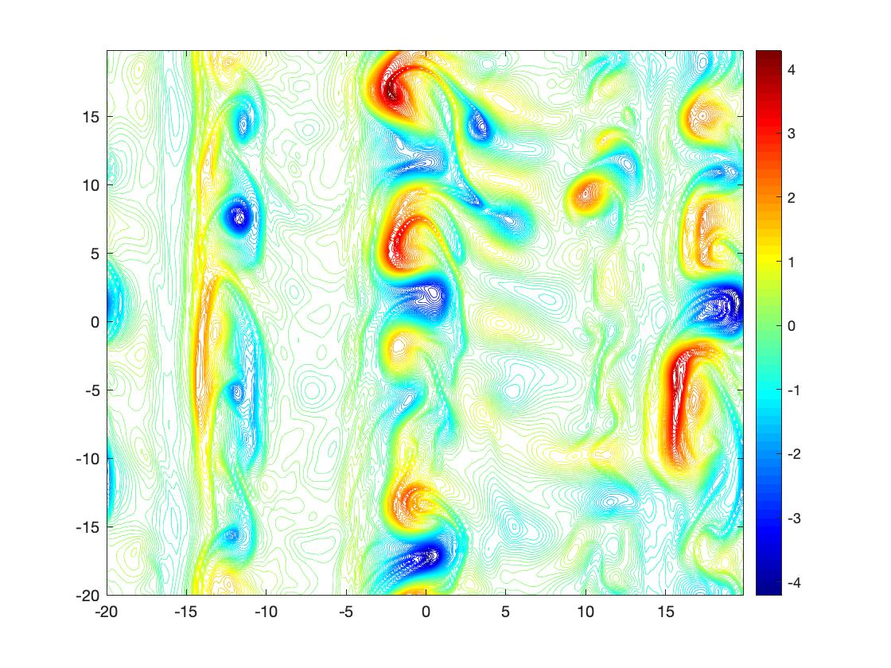

Numerical Results
t=200
t=340
t=2000
Contour plots for potential vorticity $q$
$κ=1$ stronger turbulence regime

Slide 12
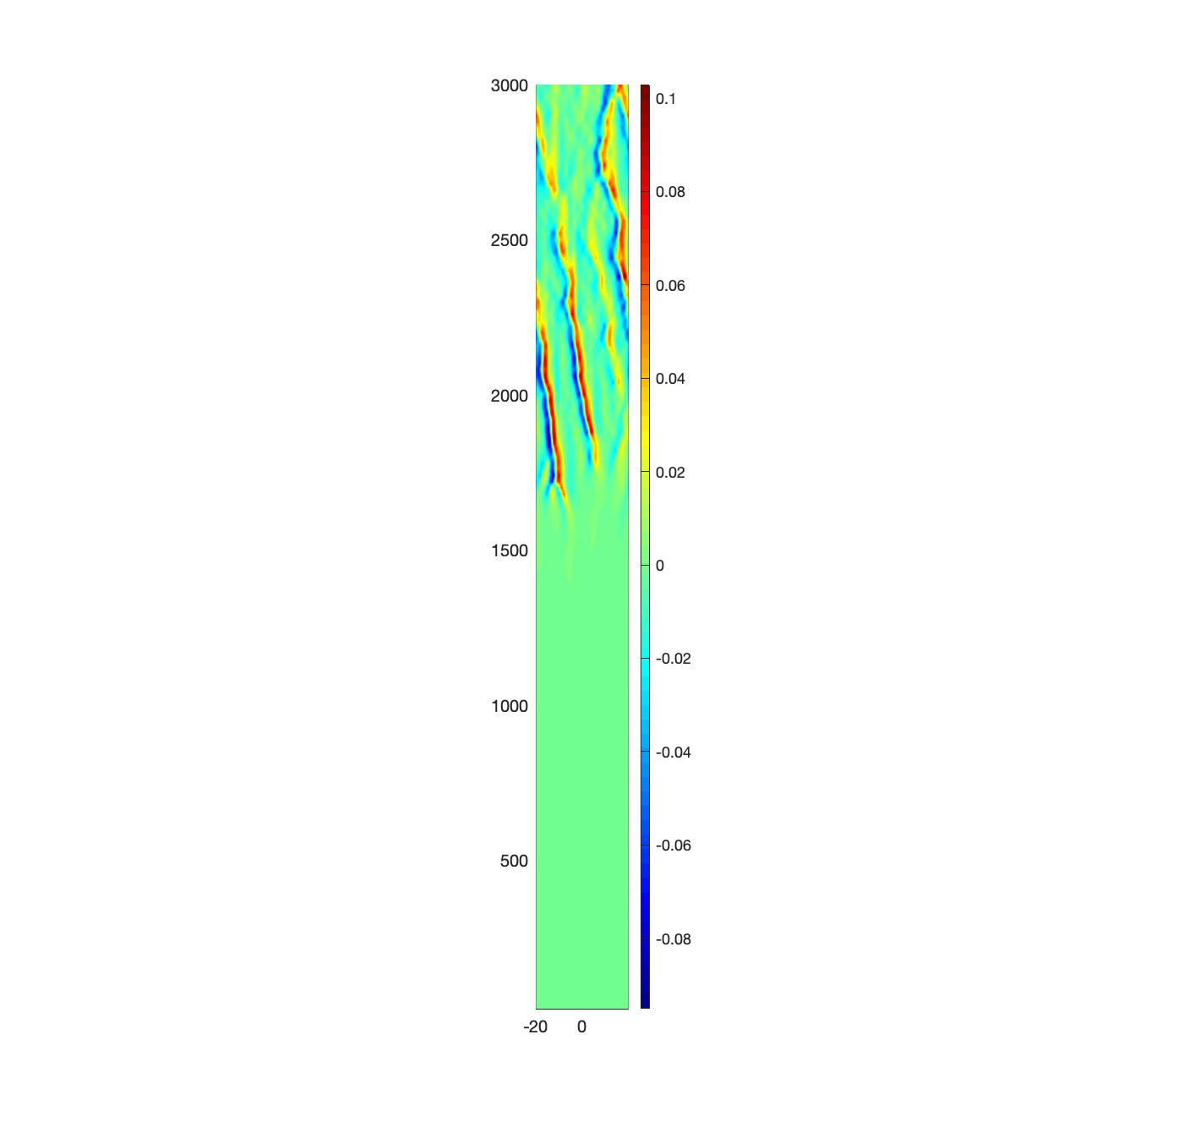
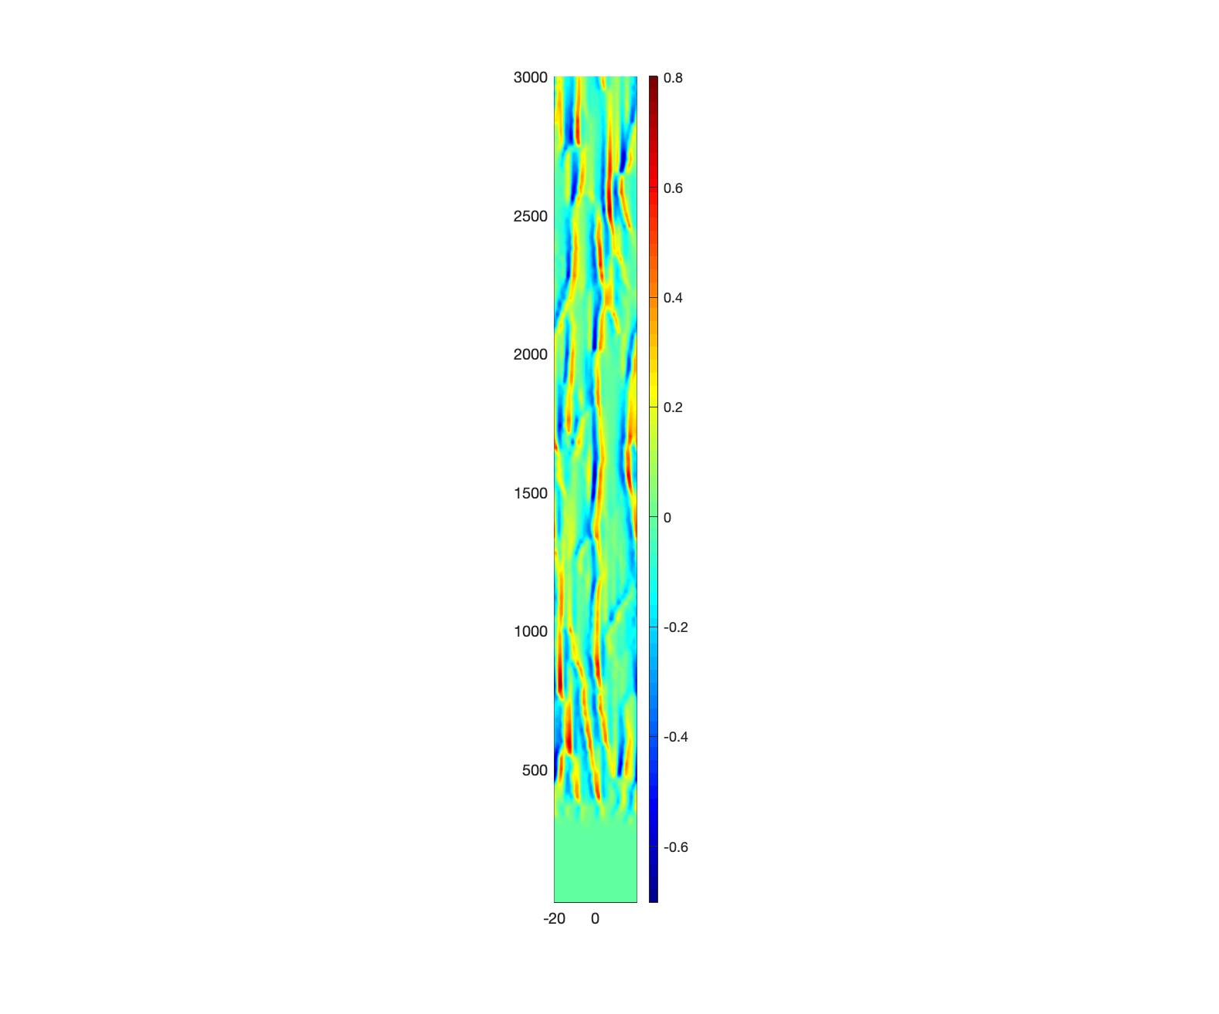

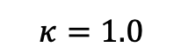
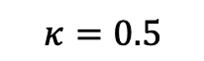
zonally averaged mean flow
$$κ=0.5$$
$$κ=1.0$$
$$\overline{v}=\frac{∂\overline{φ}}{∂x}$$

Slide 13
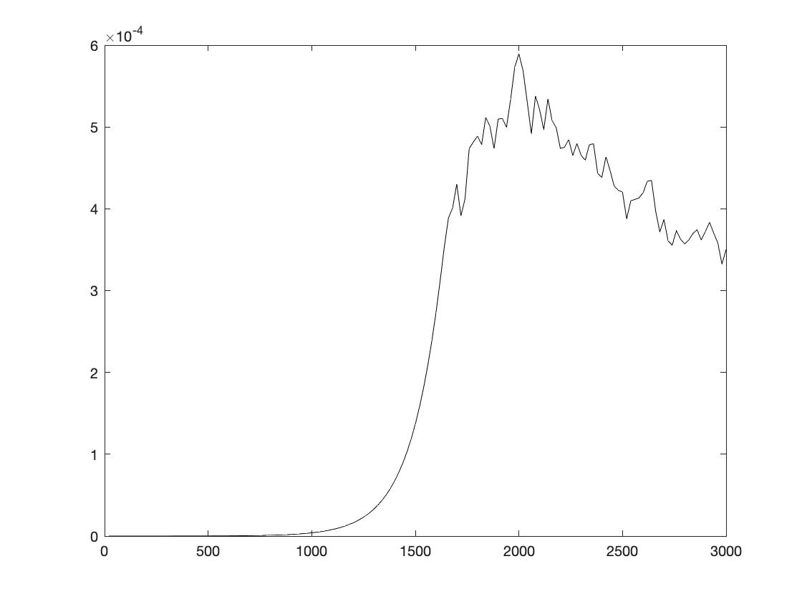
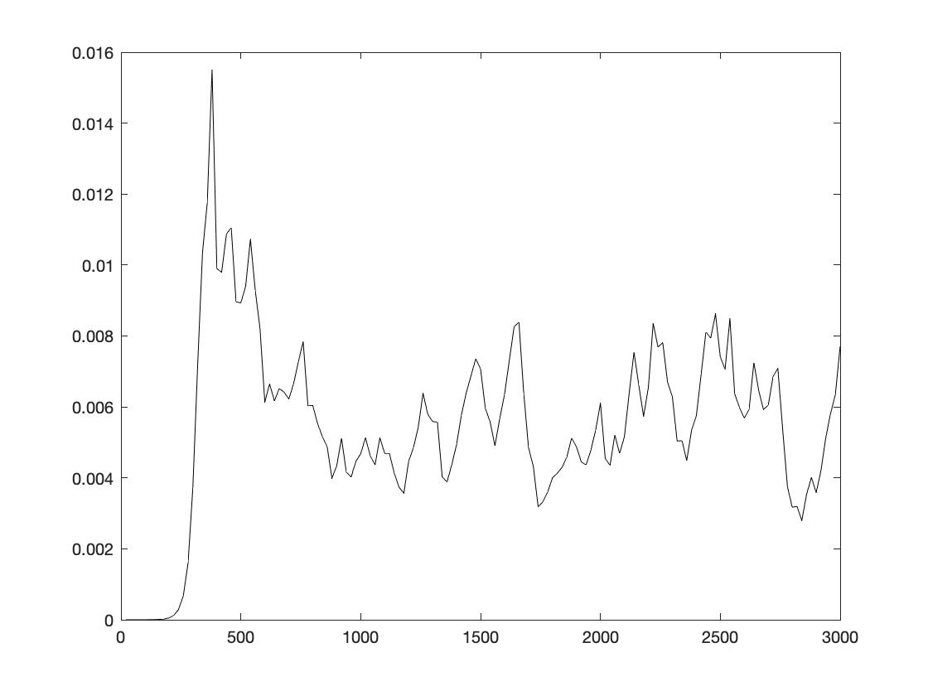
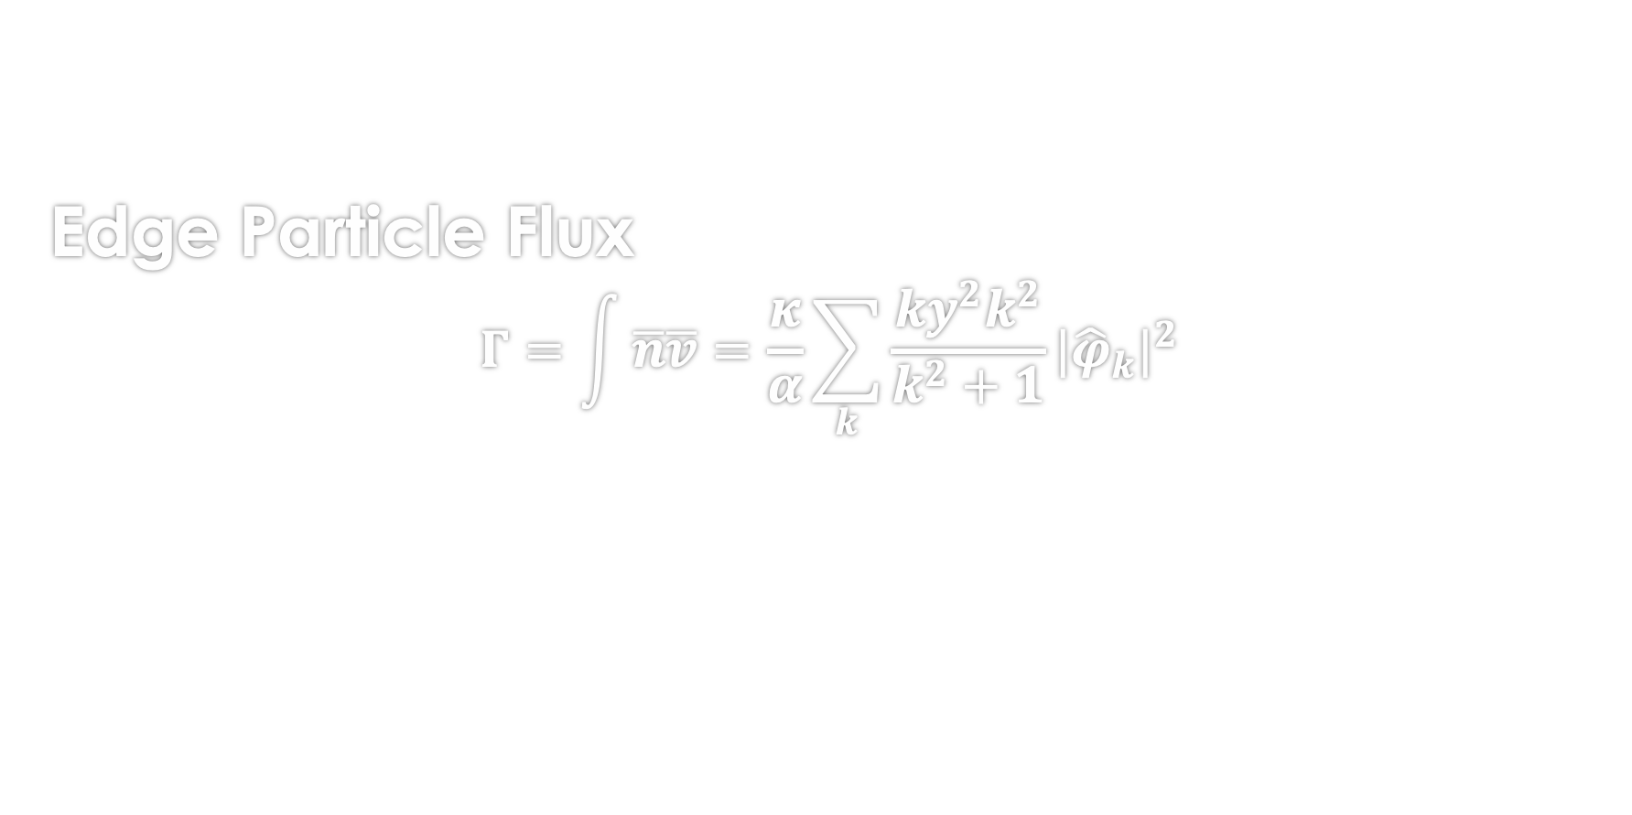
Edge Particle Flux $$Γ=\int{\overline{n}\overline{v}}=\frac{κ}{α}\sum_{k}{\frac{{ky}^{2}k^{2}}{k^{2}+1}{|{\hat{φ}}_{k}|}^{2}}$$

Slide 14
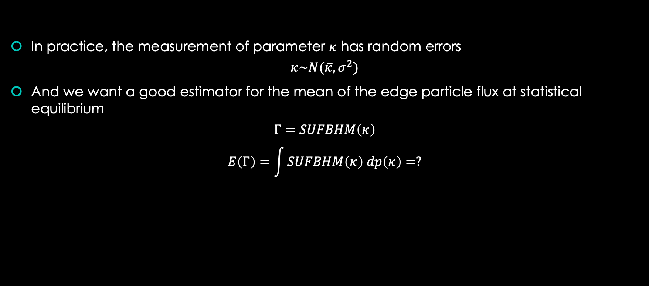
The idea of Uncertainty Quantification
In practice, the measurement of parameter $κ$ has random errors
$$κ\sim N(\overline{κ},σ^{2})$$
And we want a good estimator for the mean of the edge particle flux at statistical equilibrium
$$Γ=SUFBHM\left(κ\right)$$
$$E\left(Γ\right)=\int{SUFBHM\left(κ\right) dp\left(κ\right)=?}$$

Slide 15
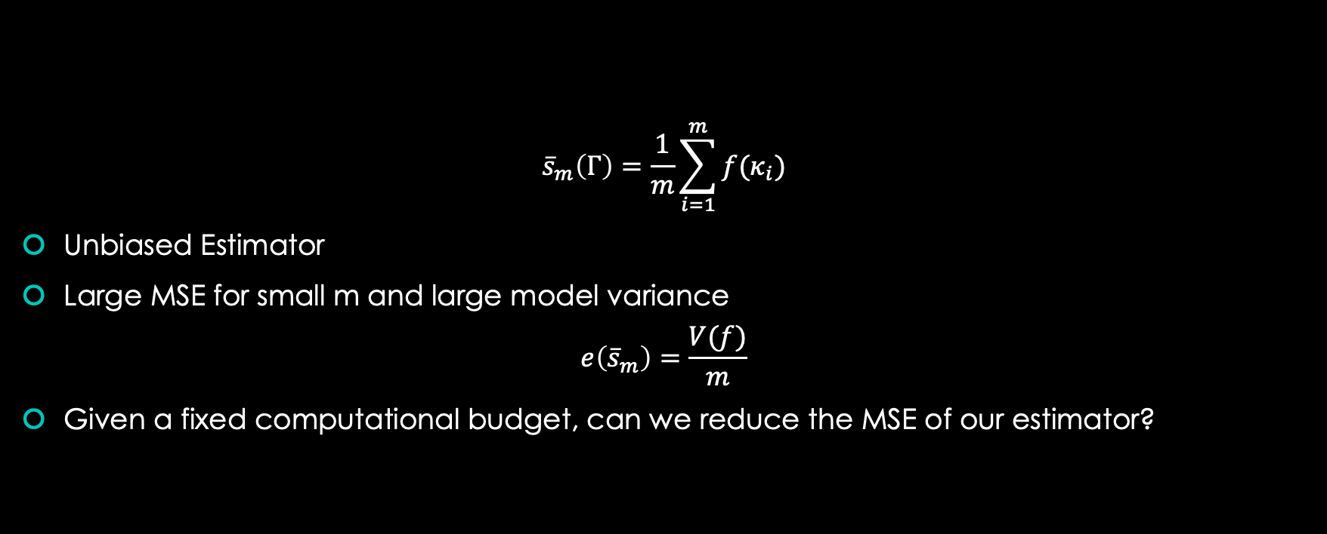
Monte-Carlo Estimator
$${\overline{s}}_{m}\left(Γ\right)=\frac{1}{m}\sum_{i=1}^{m}{f(κ_{i})}$$
Unbiased Estimator
Large MSE for small m and large model variance
$$e\left({\overline{s}}_{m}\right)=\frac{V(f)}{m}$$
Given a fixed computational budget, can we reduce the MSE of our estimator?

Slide 16
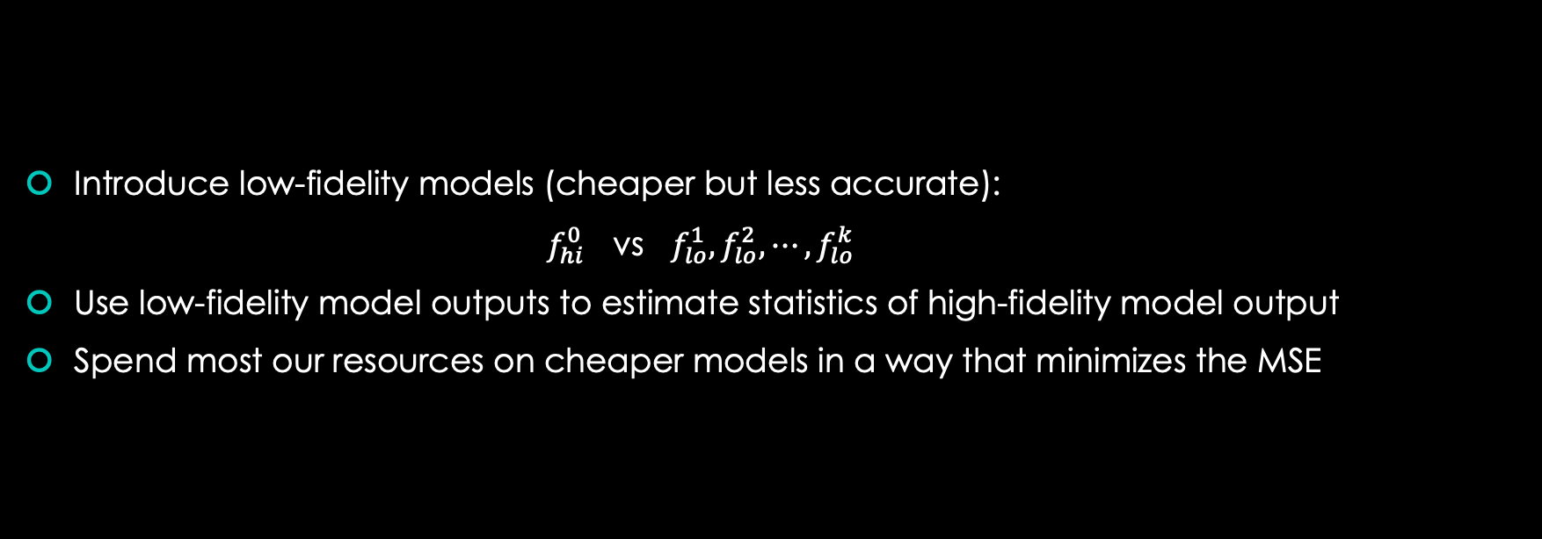
Multi-fidelity MC based on Control Variates
Introduce low-fidelity models (cheaper but less accurate):
$f_{hi}^{0}$ vs $f_{lo}^{1}, f_{lo}^{2}, ⋯,f_{lo}^{k}$
Use low-fidelity model outputs to estimate statistics of high-fidelity model output
Spend most our resources on cheaper models in a way that minimizes the MSE

Slide 17
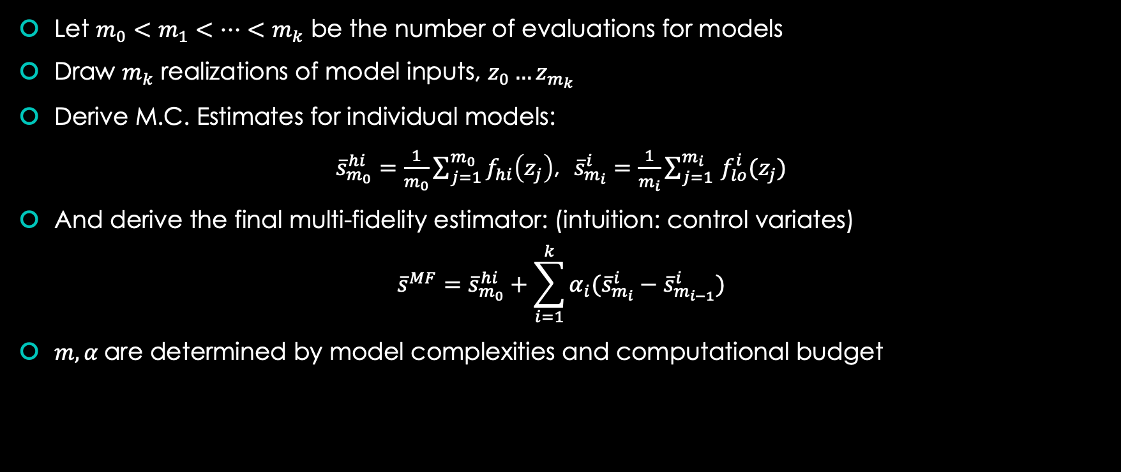
Multi-fidelity MC based on Control Variates
Let $m_{0}<m_{1}<…<m_{k}$ be the number of evaluations for models
Draw $m_{k}$ realizations of model inputs, $z_{0}…z_{m_{k}}$
Derive M.C. Estimates for individual models:
${\overline{s}}_{m_{0}}^{hi}=\frac{1}{m_{0}}\sum_{j=1}^{m_{0}}{f_{hi}\left(z_{j}\right)}$, ${\overline{s}}_{m_{i}}^{i}=\frac{1}{m_{i}}\sum_{j=1 }^{m_{i}}{f_{lo}^{i}(z_{j})}$
And derive the final multi-fidelity estimator: (intuition: control variates)
$${\overline{s}}^{MF}={\overline{s}}_{m_{0}}^{hi}+\sum_{i=1}^{k}{α_{i}({\overline{s}}_{m_{i}}^{i}−{\overline{s}}_{m_{i−1}}^{i})}$$
$m,α$are determined by model complexities and computational budget

Slide 18
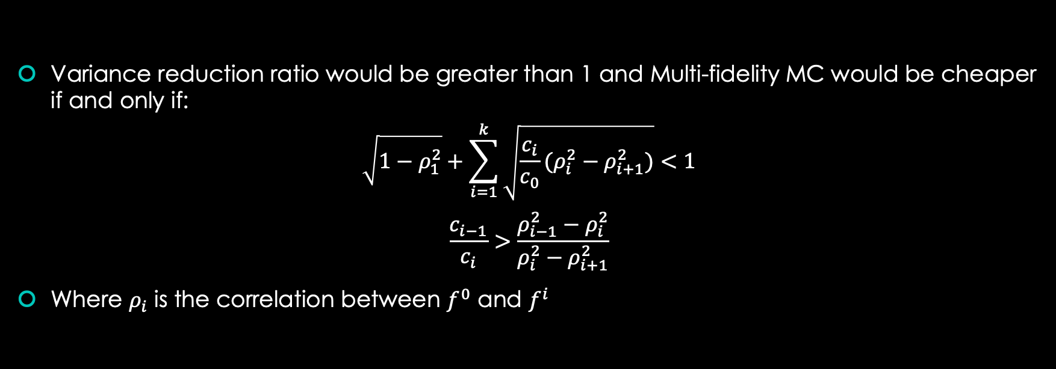
Model Selection
Variance reduction ratio would be greater than 1 and Multi-fidelity MC would be cheaper if and only if:
$$\sqrt{1−ρ_{1}^{2}}+\sum_{i=1}^{k}{\sqrt{\frac{c_{i}}{c_{0}}(ρ_{i}^{2}−ρ_{i+1}^{2})}}<1$$
$$\frac{c_{i−1}}{c_{i}}>\frac{ρ_{i−1}^{2}−ρ_{i}^{2}}{ρ_{i}^{2}−ρ_{i+1}^{2}}$$
Where $ρ_{i}$ is the correlation between $f^{0}$ and $f^{i}$

Slide 19
Correlation Considerations: Mistakes
We need reasonably high correlation between reduced models and the high fidelity model, but there are many ways this could go wrong:
First attempt:
simply reduce the grid size from 256 to 128, 64, 32
take flux value at t=2000
Poor correlation: ~0.17
Factors to be considered:
Chaotic Behavior
Phase Change
Error Accumulatio

Slide 20
Chaotic Nature

Slide 21
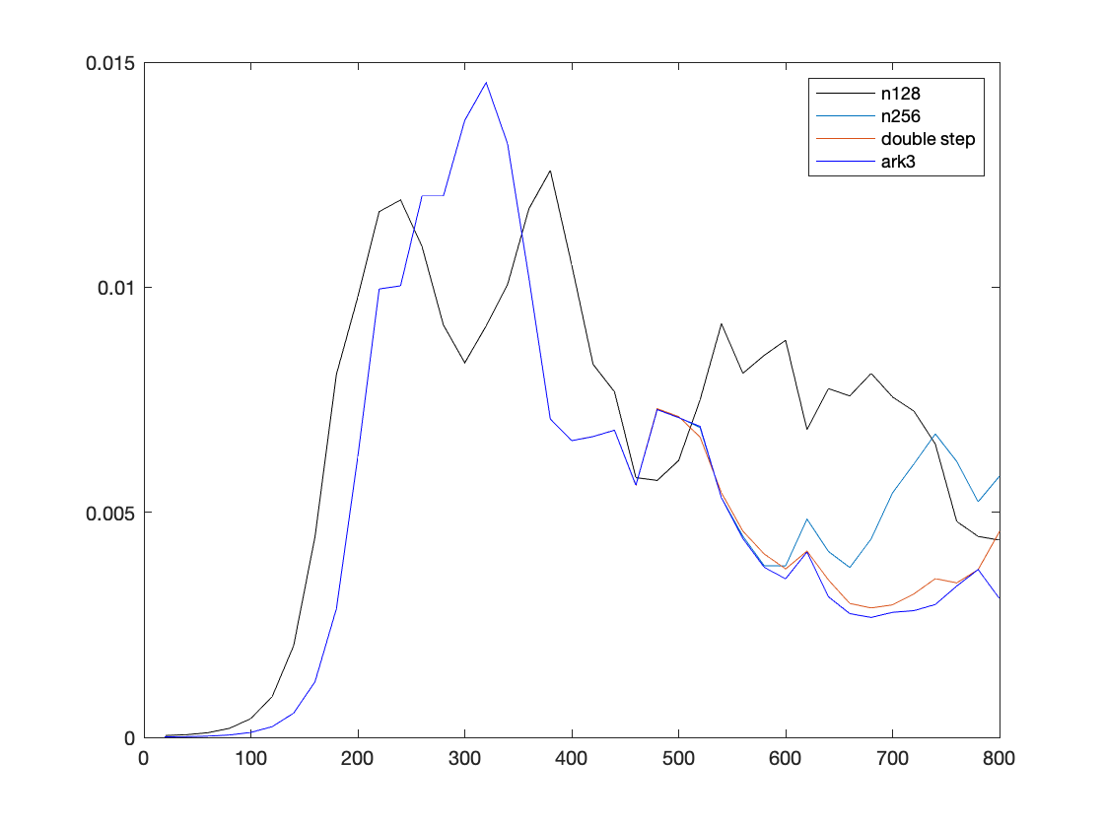
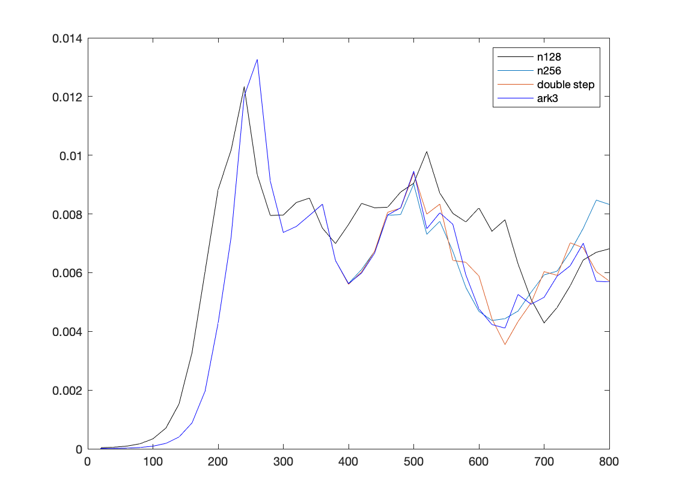
Phase Change

Slide 22
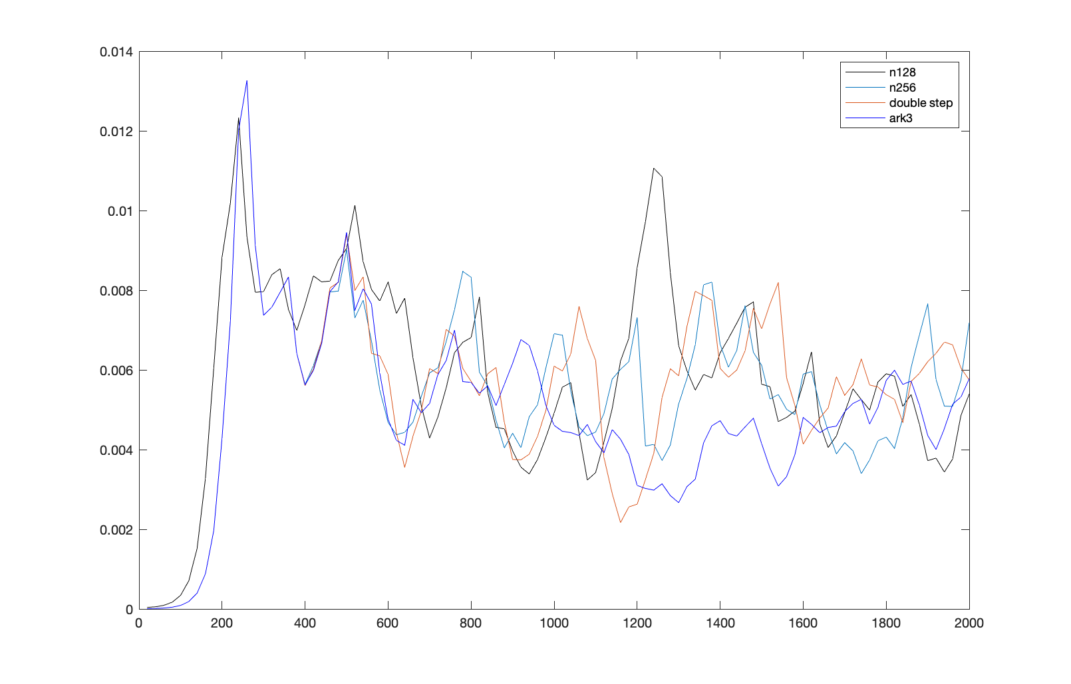
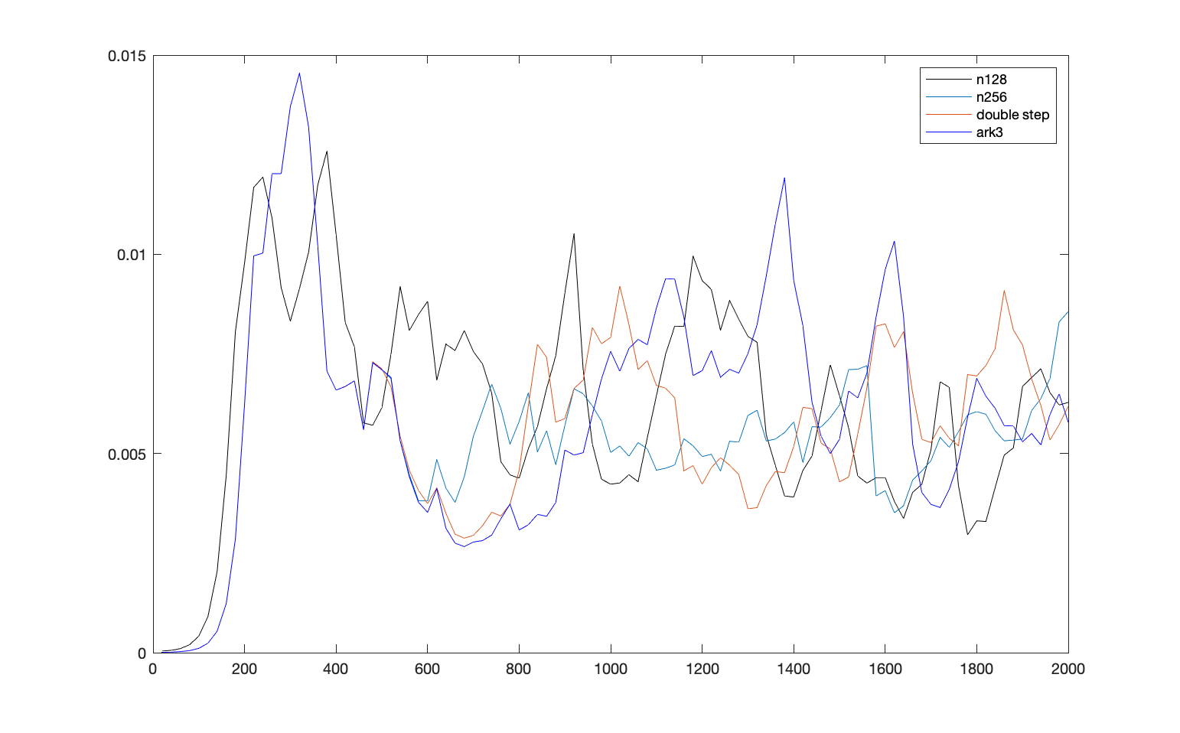
Error Accumulation

Slide 23
Modifications
Stick to 256 grid size, but use cheaper time-integration schemes such as ark3 and/or increased time-step size
Take average flux value over an appropriate interval, which has proper size, after the statistical equilibrium is achieved but before numerical error builds up

Slide 24
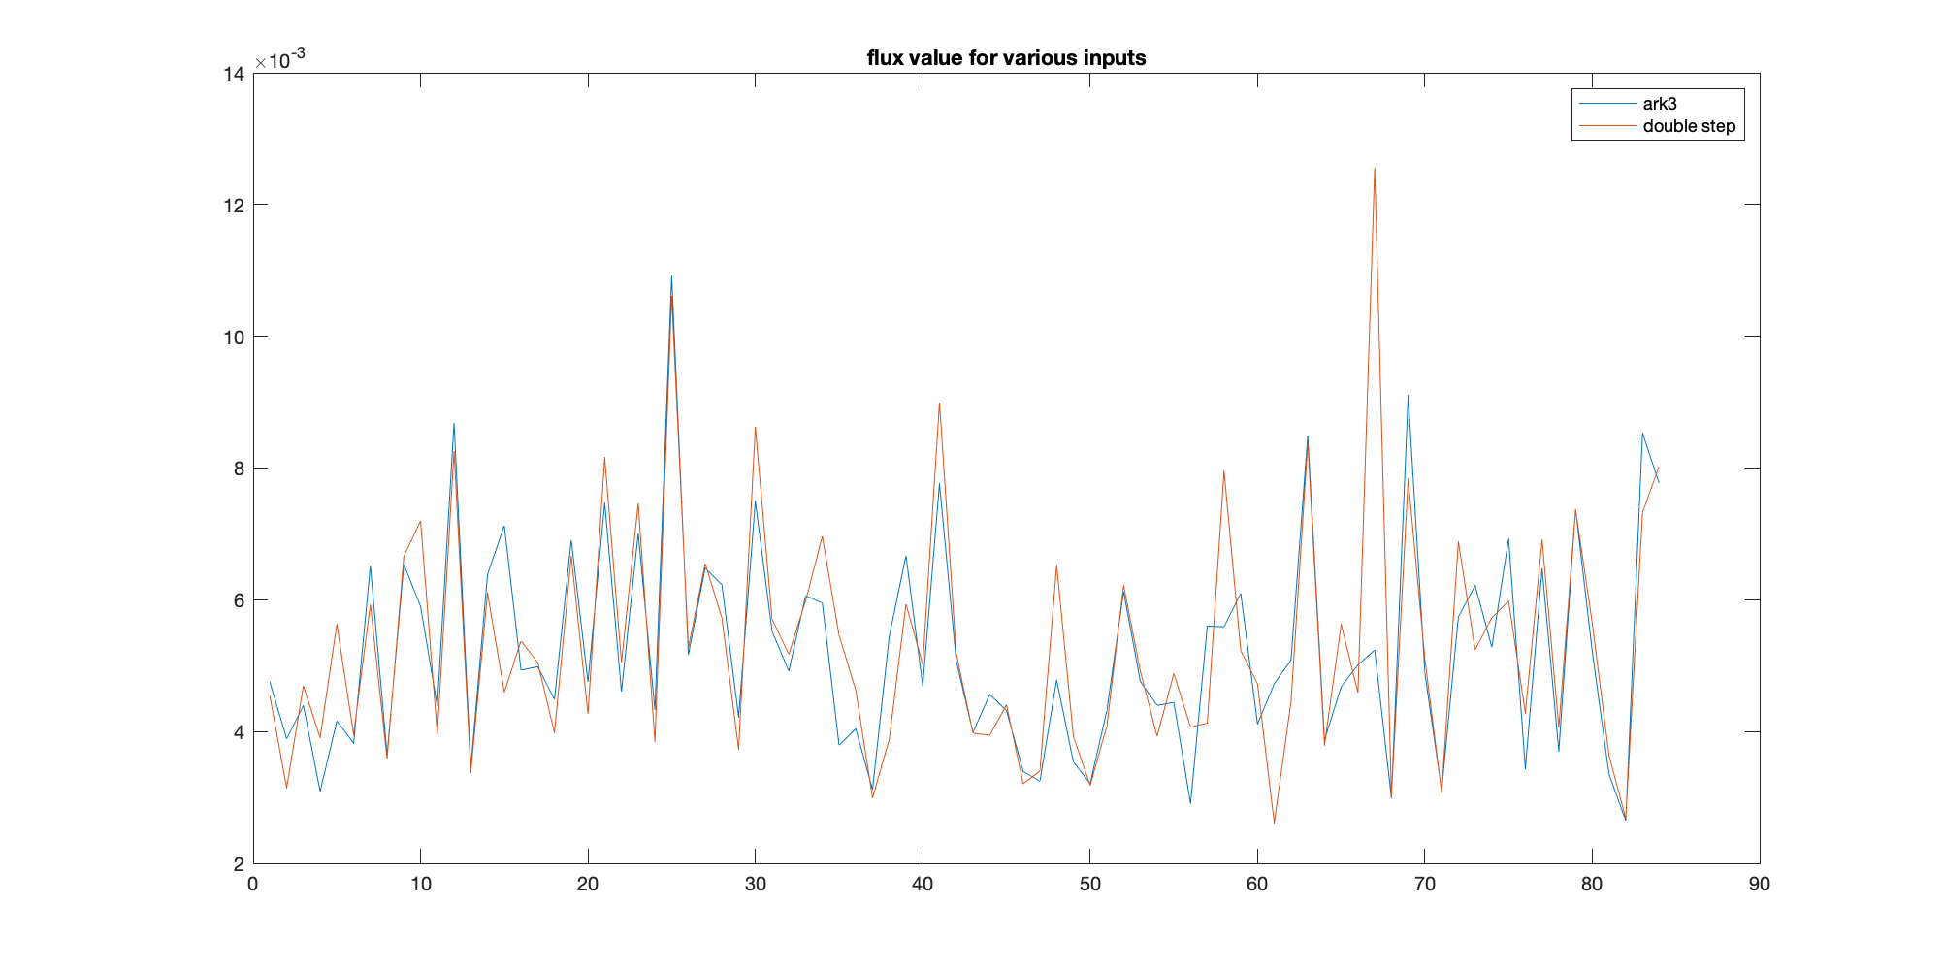
Results average flux computed between t=600 and t=700 using trapezoidal rule good correlation between reduced models

Slide 25
Results (based on 10000 sample data)
Model | Correlation | Cost
High Fidelity | 1 | 1
ARK3 | 0.865 | 1/2
ARK3 with double timestep | 0.731 | 1/4
Data-Fit (Dense-Relu NN) | 0.289 | 5000 samples, 1e-5
Data-Fit (GP regression with spectral kernel) | 0.389 | 2000 samples, 1e-5

Slide 26
Cost of Data-Fit Model
In contrast to traditional model that pays computational cost per evaluation
Data fit model requires a subset of the total budget for gathering training data and training.
Total Budge= T=T₁+T₂
Use T1 for training/constructing data fit model
Use T2 for MFMC
Wait… Once a data fit model has been trained, it can be reused over and over again.
If we want to get 10 estimators with total budget 10T, we should have:
10T=T₁+10T₂
Ideally speaking, T₁ would not matter asymptotically, but in practice it is usually very large

Slide 27
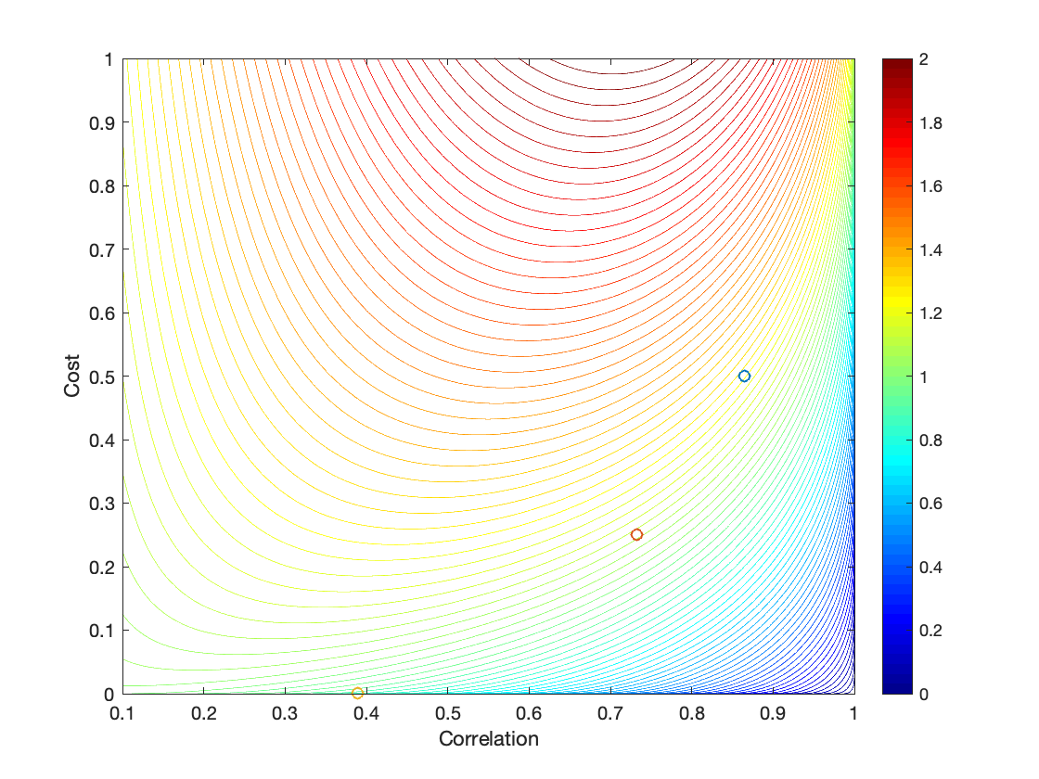
How high should the correlations be?
2 Model MFMC Variance Ratio
2 Model MFMC Variance Ratio
Model | Corr | Cost | Ratio
ARK3 | 0.865 | 1/2 | 1.240
ARK3dtime | 0.731 | 1/4 | 1.098
GP | 0.389 | 1e-5 | 0.851
3 Model MFMC Variance Ratio
Model | Corr | Cost | Ratio
ARK3 | 0.865 | 1/2 | 1.101
ARK3dtime | 0.731 | 1/4 | 0.986

Slide 28
An Experiment with total budget 10000
Method 1 Monte-Carlo
Get 100 MC estimators, each with budget 100
Method 2 MFMC
Two Models: High and GP Model
Spend 2000 on high fidelity model to construct data-fit model
Get 100 MFMC estimators each with budget 80
m₀=79, m₁=10000

Slide 29
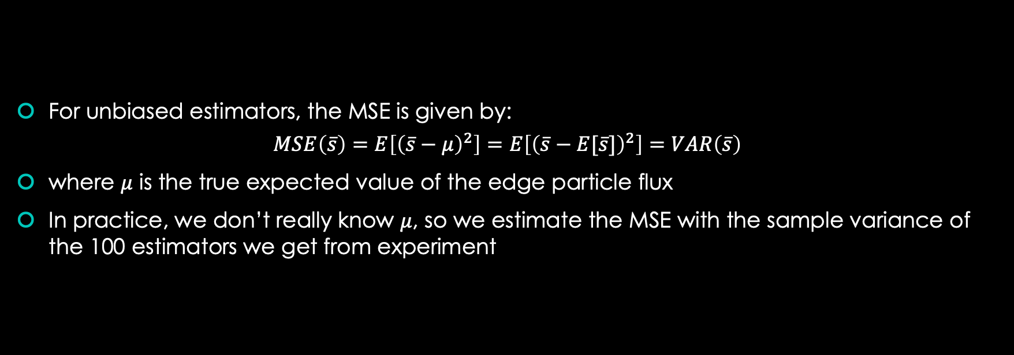
Estimating MSE
For unbiased estimators, the MSE is given by:
$$MSE\left(\overline{s}\right)=E\left[{\left(\overline{s}−μ\right)}^{2}\right]=E\left[{\left(\overline{s}−E[\overline{s}]\right)}^{2}\right]=VAR\left(\overline{s}\right)$$
where $μ$ is the true expected value of the edge particle flux
In practice, we don’t really know $μ$, so we estimate the MSE with the sample variance of the 100 estimators we get from experiment

Slide 30
Results
Method 1 is repeated 200 times (by shuffling), average estimator sample variance 2.61e-8
Method 2 is repeated 3 times, average estimator sample variance 2.49e-8

Slide 31
Future Work
Can we have better data-fit models? (This looks promising)
Can we have better physical models? (This is very hard)

